Slide 1
Canadian Unemployment Rate Analysis
Group 2 – Cadeem, Rob, Andrea

Slide 2
Agenda
Introduction of Statement
Target Audience
Data Summary
Data Preparation
Analysis Outcome
Conclusion
Limitations and Assumptions
Learnings and Takeaways

Slide 3
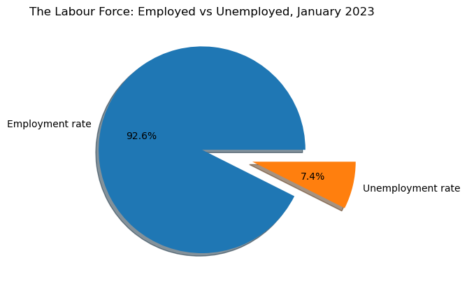
Introduction to Statement
Can unemployment rates help to predict various economic and social metrics in Canada?

Slide 4
Target Audience
Government agencies
Policy makers
Business leaders

Slide 5
Data Summary
Database | Date Range | Data Shape | No. of Columns | Data Information | Data Source
Unemployment | 1976 - 2023 | Table | 13 | Work force population Employment Unemployment Province | Statistics Canada
Household spending | 2010 – 2021 (excluding 2018, 2020) | Table | 16 | Average spending by categories Province | Statistics Canada
Immigration | 1971 - 2023 | Table | 17 | Type of migrant Age group Gender Province | Statistics Canada
Public transit | 2017 - 2024 | Table | 16 | Total transit revenue Total transit passengers | Statistics Canada

Slide 6
Data preparation
Data loading
Data cleaning
Merging datasets
Filtering datasets
Data reading

Slide 7
Immigration vs Unemployment Rates
Do unemployment rates affect immigration in Canada?

Slide 8
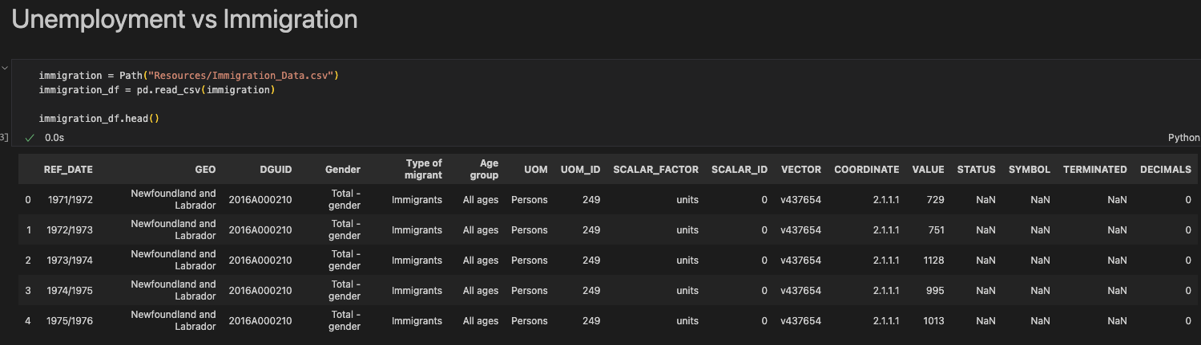
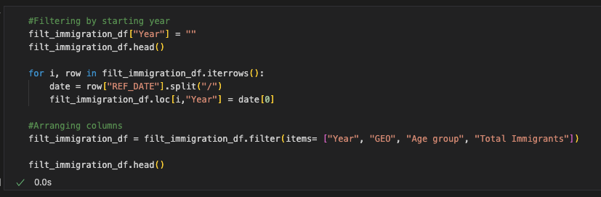
Data preparation

Slide 9
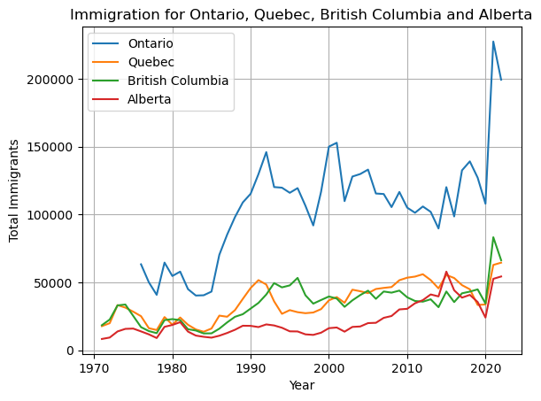
Analysis

Slide 10
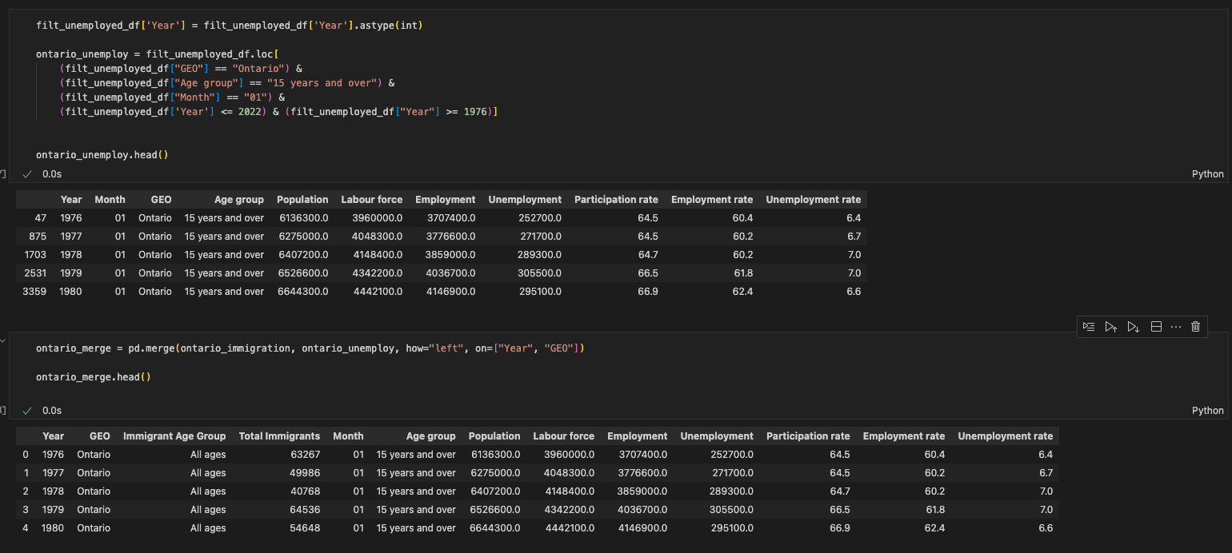
Data preparation

Slide 11
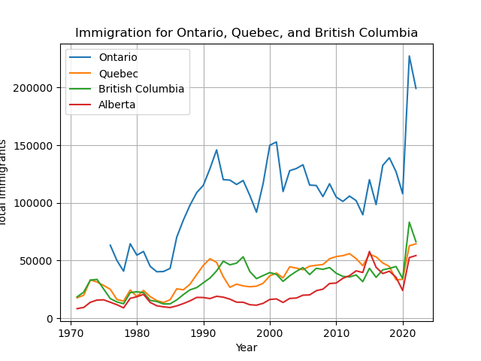
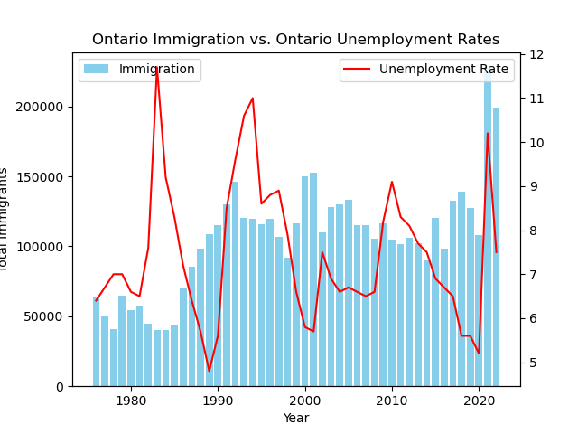
Analysis

Slide 12
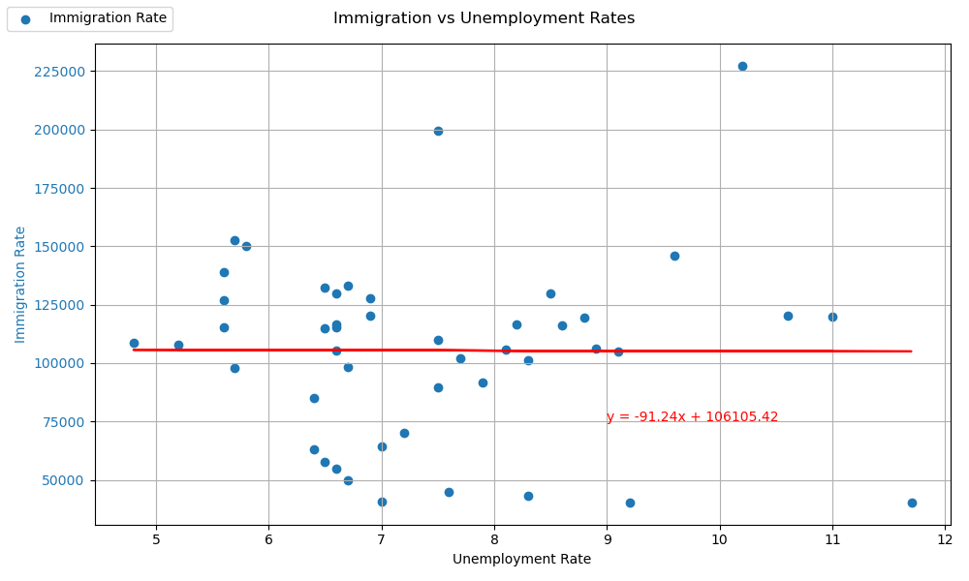

Analysis

Slide 13
Public Transit vs Unemployment Rates
Do unemployment rates affect public transit in Canada?

Slide 14
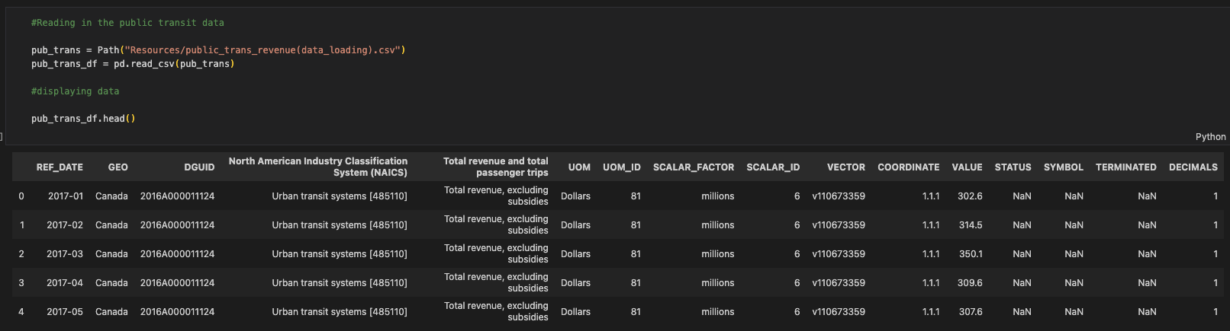
Data preparation

Slide 15
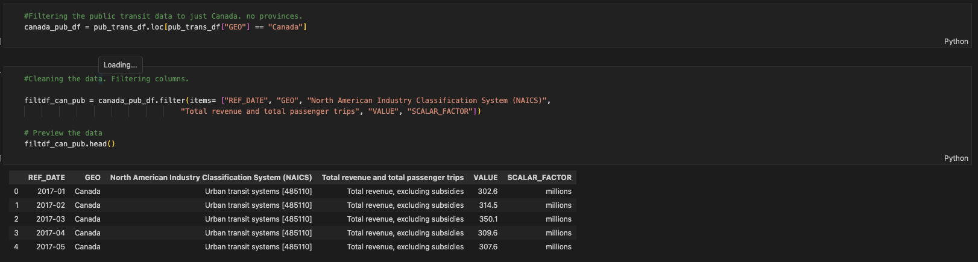
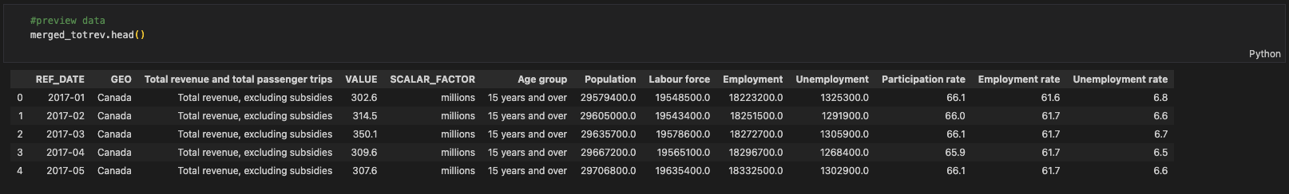
Data preparation

Slide 16
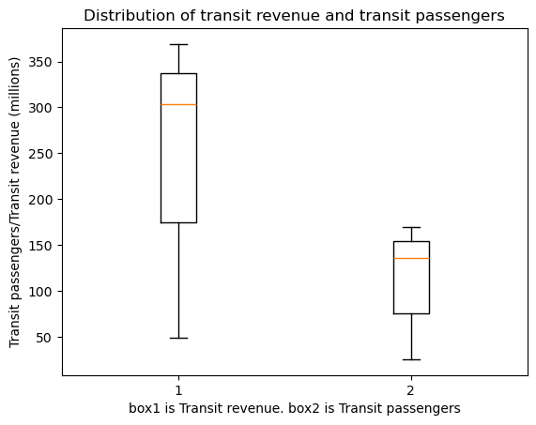
Analysis

Slide 17
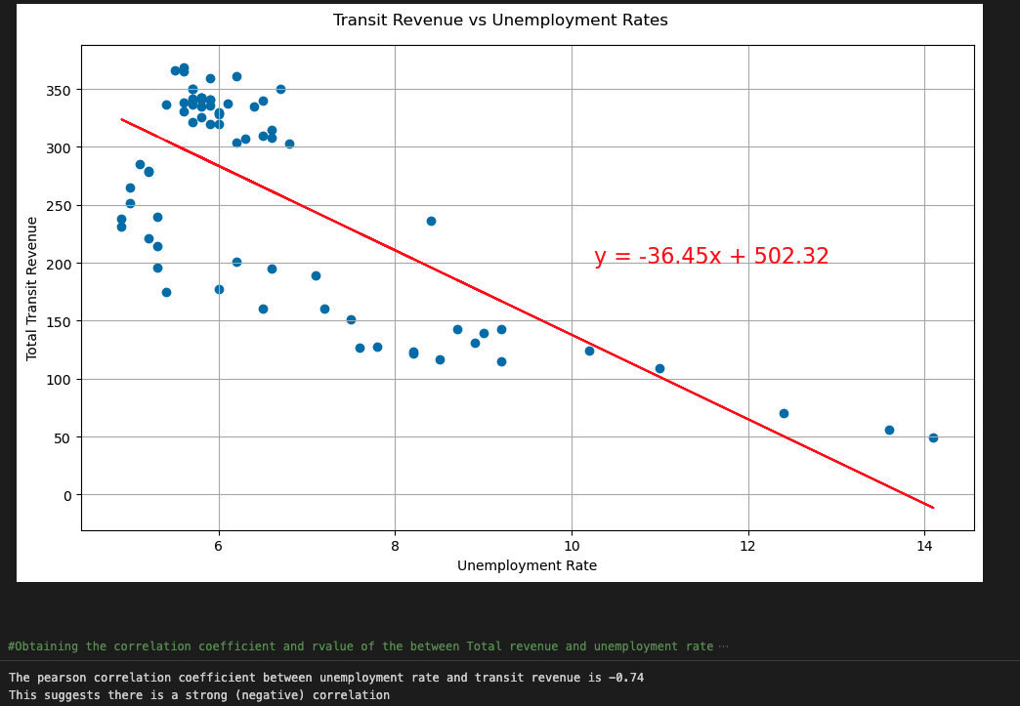
Analysis

Slide 18
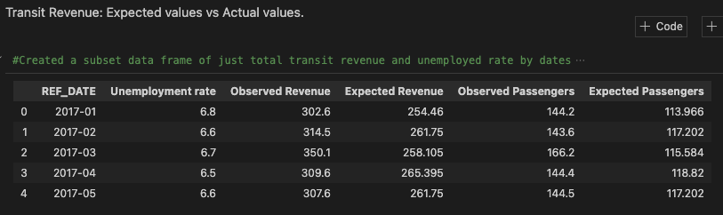
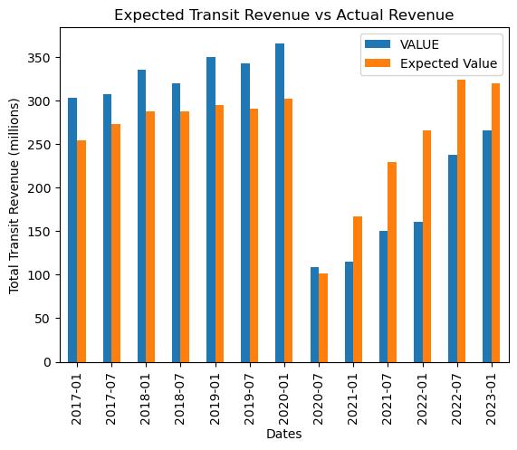
Analysis

Slide 19
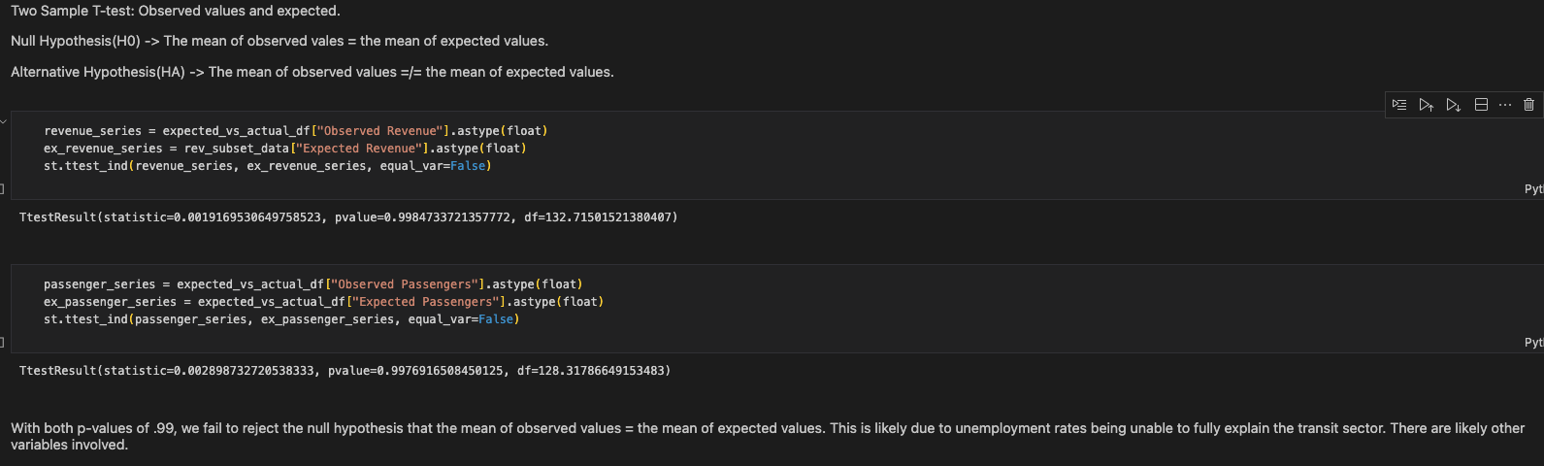
Analysis

Slide 20
Household Spending vs Unemployment Rates
Do unemployment rates affect household spending in Canada?

Slide 21
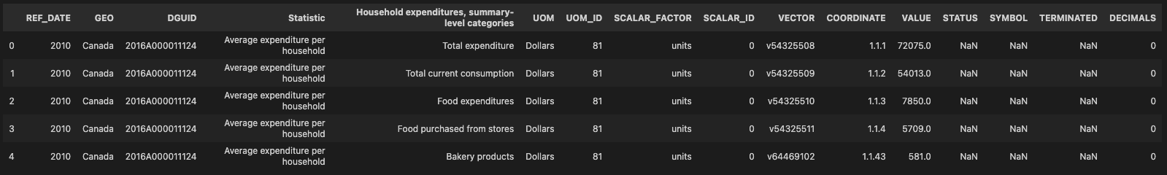
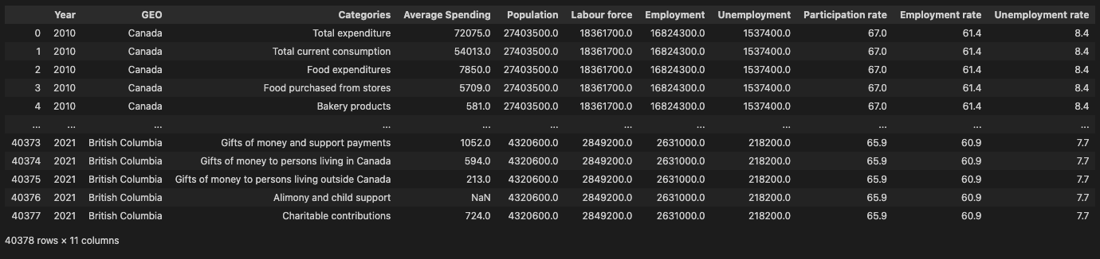
Data Preparation
Notes:
The dataset includes average household spending by multiple

Slide 22
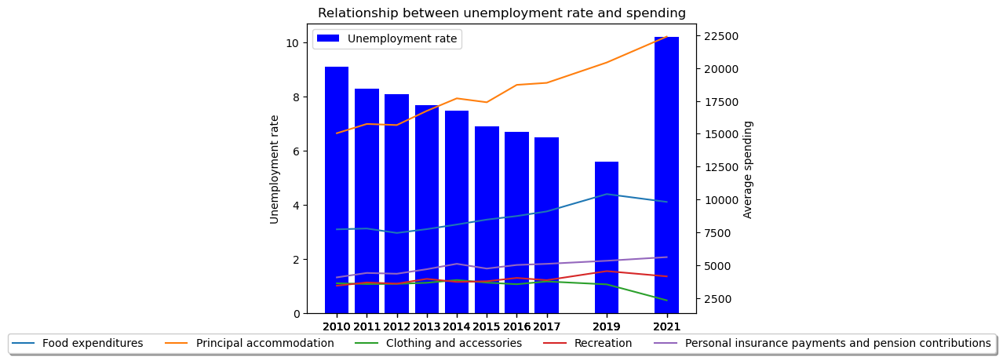
Analysis

Slide 23
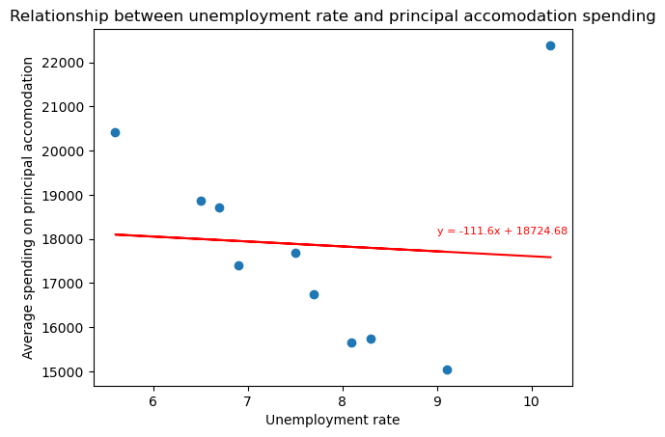
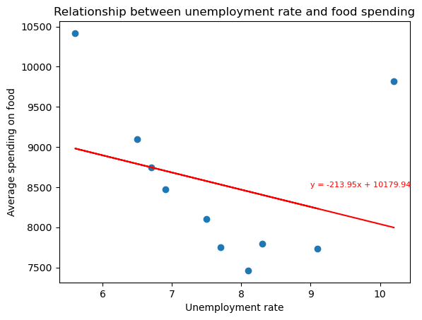
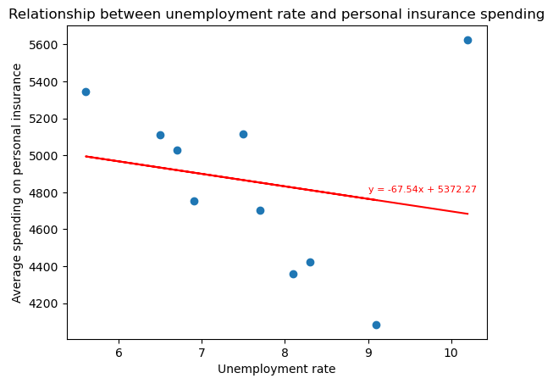
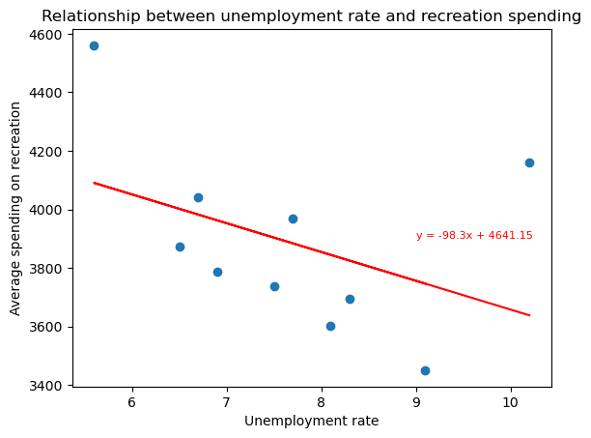
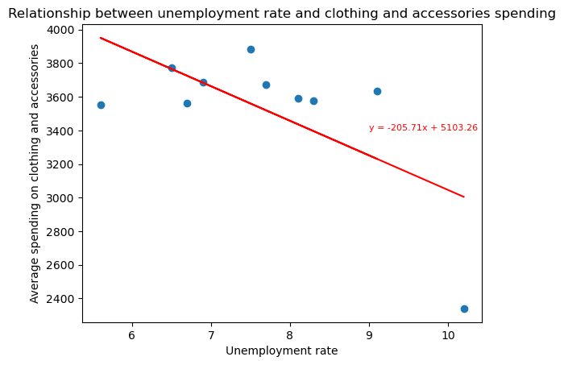
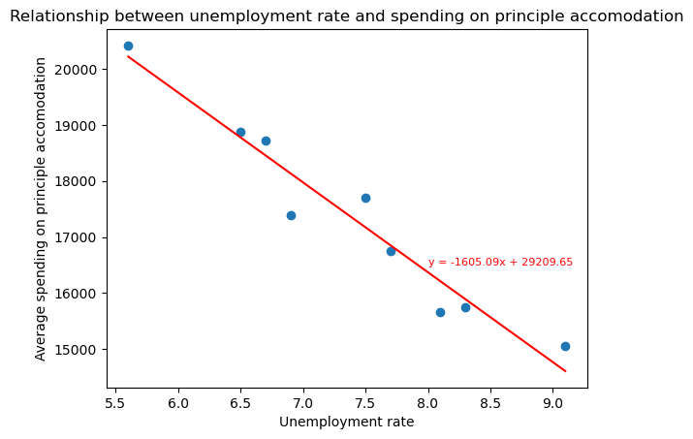
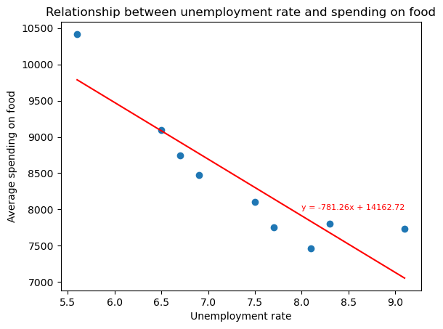
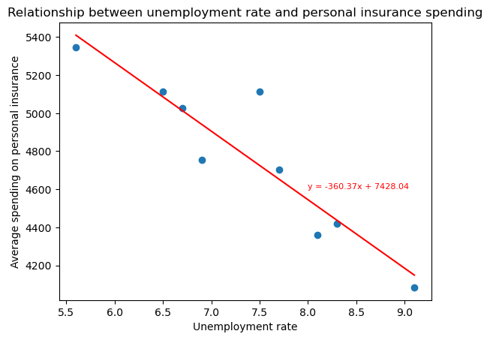
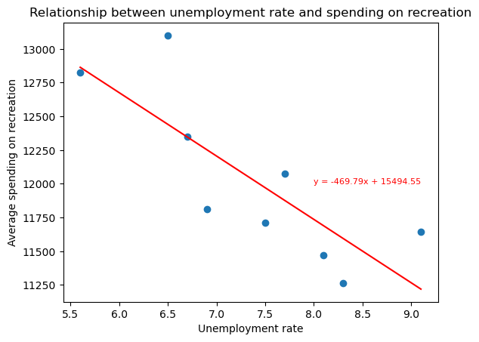
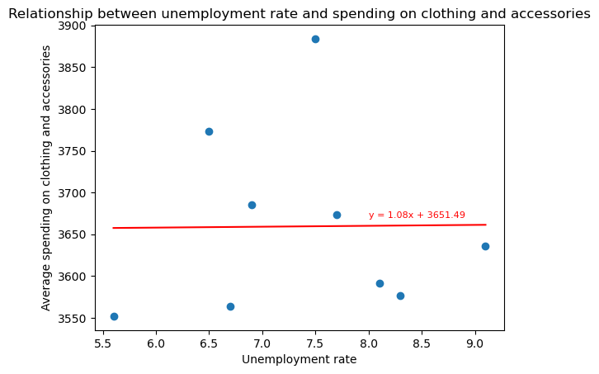
Analysis
With COVID-19 data
Without COVID-19 data

Slide 24
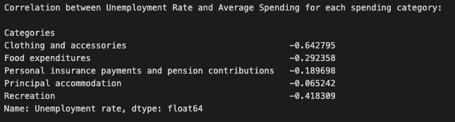
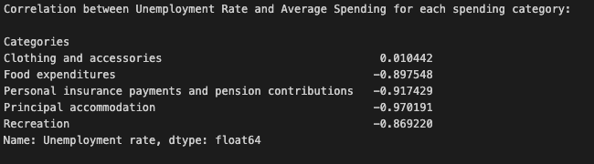
Analysis
With COVID-19 data
Without COVID-19 data

Slide 25
Conclusion
Immigration
Unemployment does not appear to significantly correlate with immigration.
Public transit
Unemployment rates seems to be negatively correlated with public transit.
However, unemployment does not fully explain public transit on its own.
Household spending
Unemployment rates is having a strong negative relationship with spending on necessities such as principal accommodation, food and personal insurance payment and pension contribution.
So, can unemployment rates help to predict various economic and social metrics in Canada?
Maybe…

Slide 26
Limitations and Assumptions
The timeframe of the dataset is not aligned
Data during Covid-19 is a big outlier in most of the dataset
Inflation is not included in the analysis for household spending
Due to time constraints, we could not analyze all provinces

Slide 27
Learnings and Takeaways
Github is frustrating/ merge conflicts suck!
Collaboration and planning is very important
The outcomes of our analysis did not always align with our predictions

Slide 28
Going forward…
We would like to…
Analyze data for all provinces
Do more comparison on data before and after COVID-19
Account inflation in our analysis of household spending
Explore related variables to some of our analysis

Slide 29
Thank you

